Slide 1

An Integrated Approach to Network Intrusion Detection and Prevention
Group Members
AM.EN.U4ECE15020 : B Bhanu Prakash
AM.EN.U4ECE15028 : Kaki Yeswanth
AM.EN.U4ECE15033 : Sai Srinivas
AM.EN.U4ECE15052 : Somasale Balaji
AM.EN.U4ECE15061 : Y Chandra Sekhar
Guided by: Aswathy K Nair

Slide 2
Introduction
Software that detects network intrusions protects a computer network from unauthorized users.
Helps in distinguishing between bad connections called “Intrusions” and good connections.
These attacks fall into four main categories. They are:
DOS(Denial-Of-Service)
R2L (Remote to Local)
U2R (User to Root)
Probing

Slide 3
Machine Learning:
It is a branch of computer science that is closely related to Data Mining.
It is a study of algorithms and statistical models to improve the performance of a specific task.
These algorithms are used in applications of Intrusion Detection in Computer Networks, spam emails and some other areas.
There are many ways in which the machine learns, but the three important ways are

Slide 4
Supervised Learning:
It is the branch of machine learning that maps an input variable(x) to an output variable (Y) based on the labeled training Data. Y=f(x).
Unsupervised Leaning:
It is the branch of machine leaning that tests the data which has not been labeled or categorized.
This algorithm classifies the unsorted data by itself based on patterns.
Reinforcement Learning:
It is the branch of Machine learning that works on the principle of feedback of the data.

Slide 5
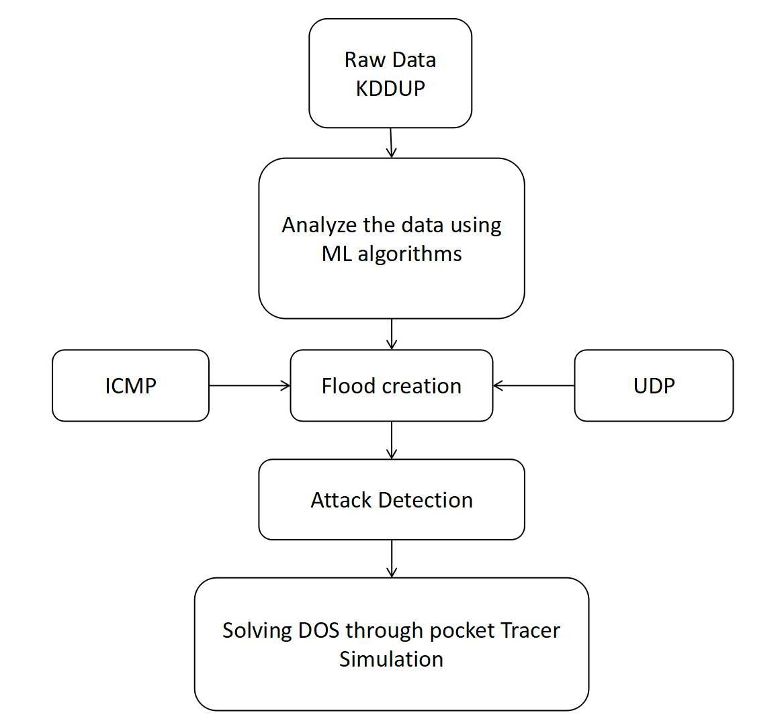
BLOCK DIAGRAM

Slide 6
Methods adopted:
Intrusion Detection:
KNN(K-Nearest Neighbours)
SVM(SUPPPORT VECTOR MACHINE)
Blocking IP :
Comparing Incoming IP Address with Blacklist IP & Blocking them accordingly(Cisco Packet Tracer)
Attacks Implementation & Solving:
a)POD
b)UDP Flooding
Software tools:
Python,Cisco Packet Tracer,Wire-shark,UDP UNICORN.

Slide 7
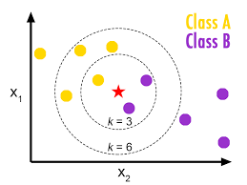
K Nearest Neighbors(KNN):
KNN is one of the simplest algorithm used for classification and it is also most used learning algorithm.
KNN is a type of instance-based learning, or lazy learning, where the function is only approximated locally and all computation is deferred until classification.

Slide 8
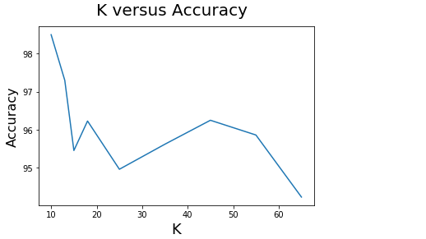
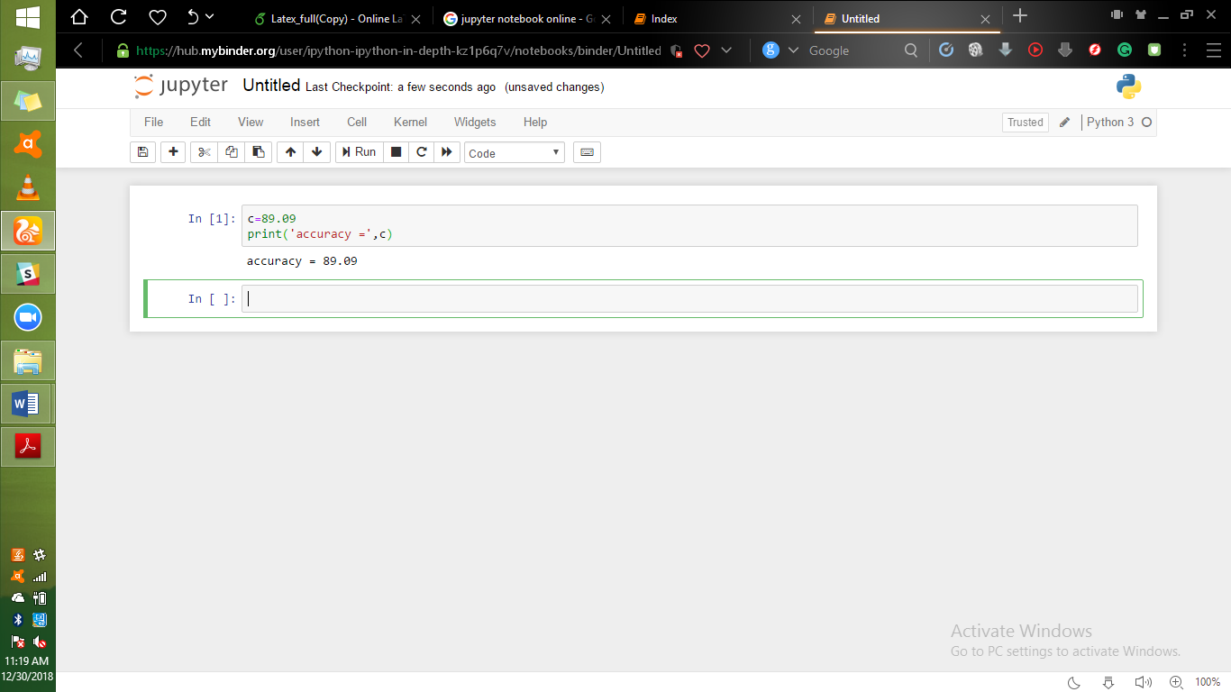
Results
Accuracy Report:
Based on several research papers and after performance calculation,K(No.of Neighbours) value should be around half of the length of training set.

Slide 9
SVM(Super Vector Machine)
A Support Vector Machine (SVM) is a discriminative classifier formally defined by a separating hyperplane
SVM takes labeled training data as input and outputs an optimal hyperplane which categorizes new examples.
Support Vector Machines (SVMs) are one of the widely used intrusion detection techniques.
A SVM algorithm tries to construct a hyperplane that has the largest distance to the nearest training-data point of any class in a high or infinite dimensional space, which can be used for classification and other tasks.

Slide 10
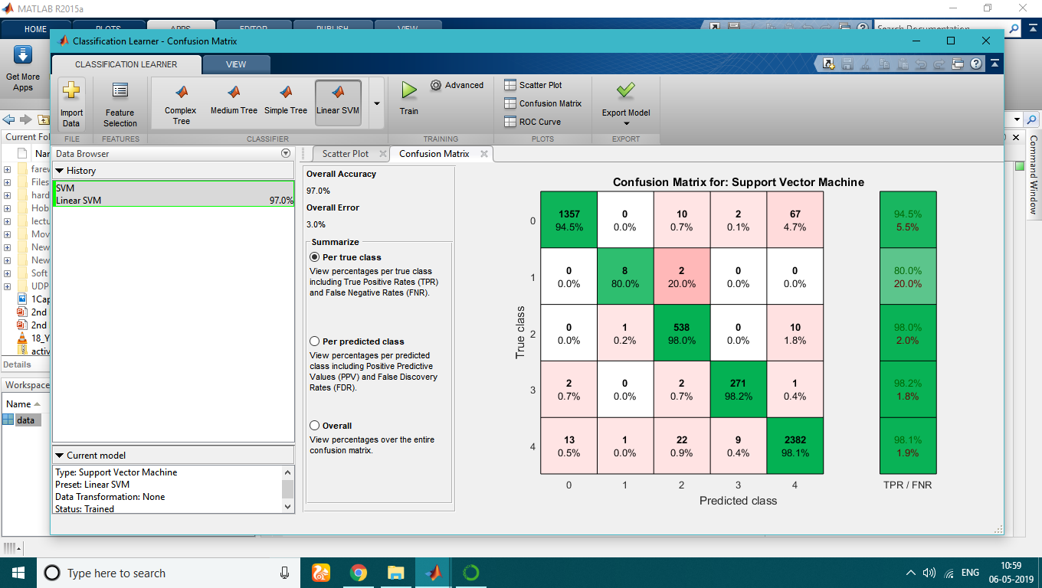
Class 0 : DOS
Class 1 : U2R Class 2 : R2L Class 3 : Probing Class 4 : Normal

Slide 11
Class 0 : Intrusive
Class 1 : Normal

Slide 12
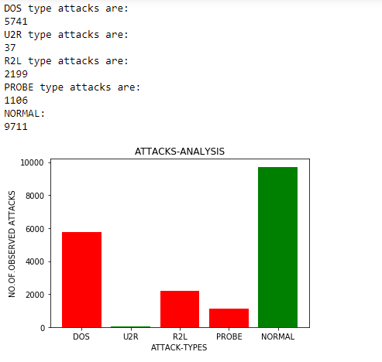
Survey on Datasets to detect most prominent attack:
As per the survey results, it is obvious that the most dangerous attack is DOS.
Our main motto is to solve DOS type attacks using wireshark and python combinely.

Slide 13
What is Wireshark Packet Sniffer( Analyser)?
The basic tool for observing the messages exchanged between executing protocol entities is called a packet sniffer.
“Sniffs” ➔ Messages being sent/received from computer.
A packet sniffer is an application which can Capture and Analyse network.
Stores and Display the contents of various protocol fields.
Used in labs (display the contents of messages from protocols at different levels of the protocol)
Wireshark is a packet analyzer that uses a packet capture library in your computer.

Slide 14
UDP FLOOD:
“UDP flood” is a type of Denial of Service (DoS) attack in which the attacker overwhelms random ports on the targeted host with IP packets containing UDP datagrams.
The receiving host checks for applications associated with these datagrams and—finding none—sends back a “Destination Unreachable” packet. As more and more UDP packets are received and answered, the system becomes overwhelmed and unresponsive to other clients.
In the framework of a UDP flood attack, the attacker may also spoof the IP address of the packets, both to make sure that the return ICMP packets don’t reach their host, and to anonymize the attack.

Slide 15
ATTACK DESCRIPTION:
User Datagram Protocol (UDP) is a connectionless and sessionless networking protocol.
Since UDP traffic doesn’t require a three-way handshake like TCP, it runs with lower overhead.
In the absence of an initial handshake, to establish a valid connection, a high volume of “best effort” traffic can be sent over UDP channels to any host.
UDP does not define specific packet formats, and thus attackers can create large packets (sometimes over 8KB), fill them with junk text or numbers and send them out to the host under attack.

Slide 16
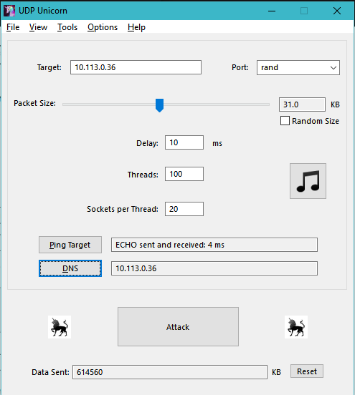
Implementation of UDP Flood Attack : UDP Unicorn:
UDP Unicorn is a free and open source DoS attack software. The software attacks a computer's network connection by repeatedly sending UDP packets with garbage data.
Features
Multithreaded UDP flooder
Port Scanner
Active Connection Monitor
Network Information - Public IP Address
DNS
ICMP send and receive (Ping)
Target random ports and use random packet size
Ability to play music

Slide 17
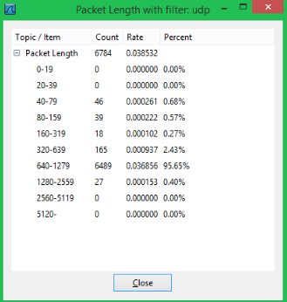
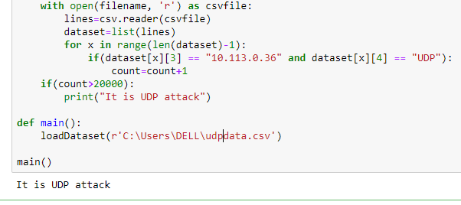
Wire-Shark Analysis & Python Implementation:

Slide 18
Implementation of PoD using ICMP Protocol:
ICMP Protocol:
The Internet Control Message Protocol(ICMP) is a supporting protocol in the Internet Protocol Suite.
It is used by Network devices, including routers, to send error messages and operational information.
PoD(Ping of Death):
It is a attack in which the attacker attempts to crash, destabilize or freeze the targeted device by sending oversized packets using a simple ping command.

Slide 19
Implementation of PoD using ICMP Protocol:
After classifying the type of attack, we are implementing PoD using Wireshark Packet sniffer analyzer manually.
Using command prompt we are sending number of requests to the destination IP address through ‘PING’ command from source which are connected in the same LAN.
Then we are analyzing the data using Wireshark.
By using Python Programming language, we have counted the number of times we got requests from the source.
If the requests exceeds the threshold value, then we have classified it as Ping of Death.

Slide 20
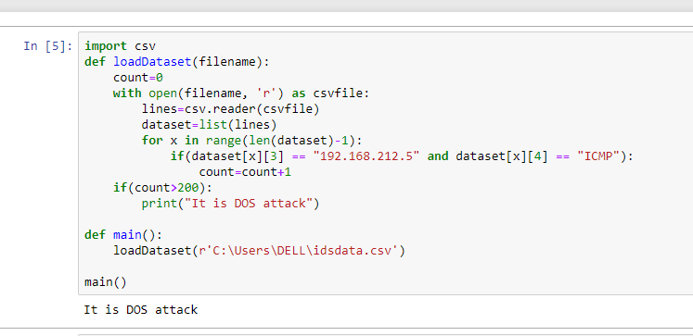
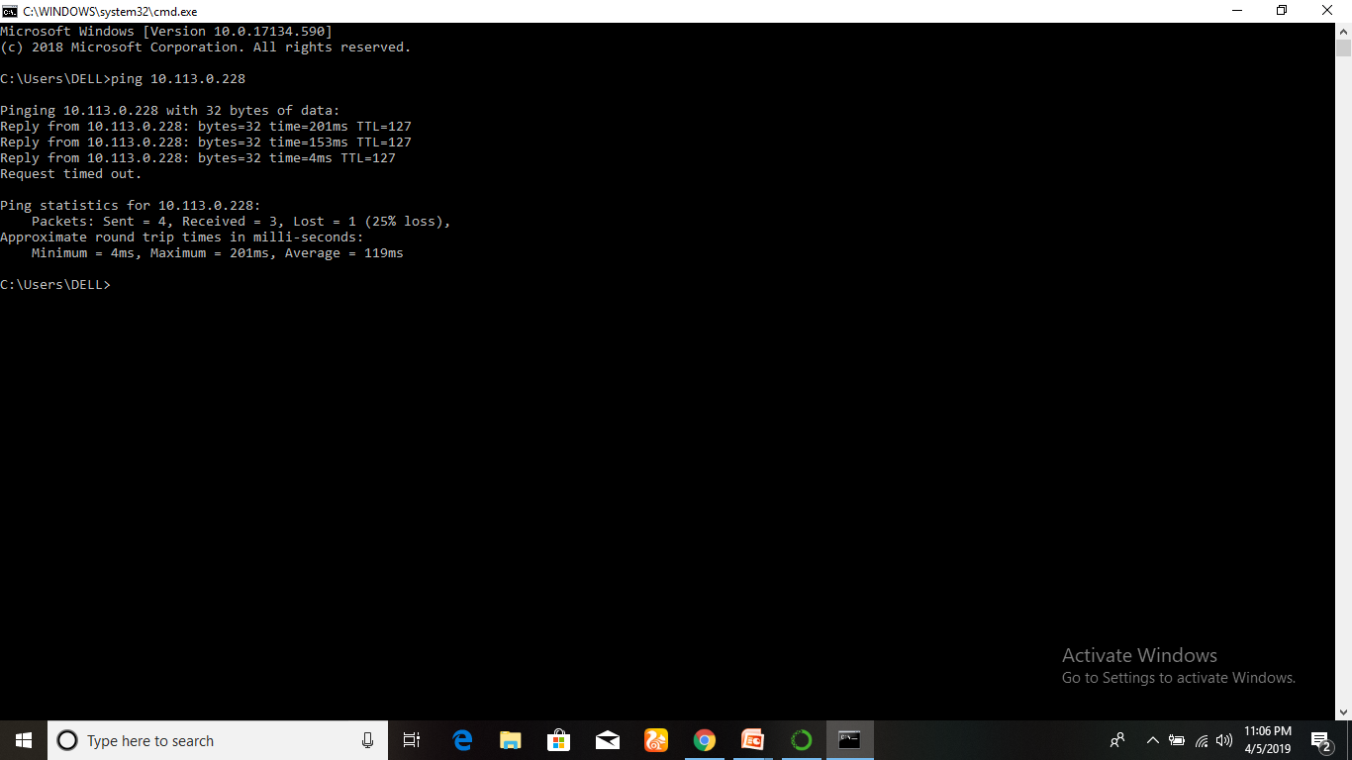
Implementation of PoD using ICMP Protocol:

Slide 21
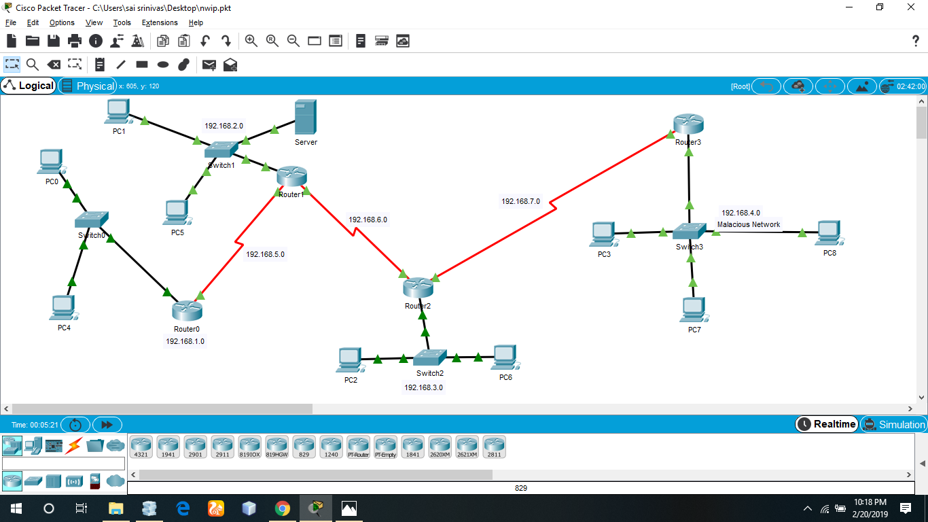
Standard IP access list in Router
Configuring access lists at your router to control access to a network: access lists can prevent certain traffic from entering or exiting a network
Standard Access-list – These are the Access-list which are made using the source IP address only.
In our MAN we are blocking 192.168.4.0 and accessing remaining all networks.

Slide 22
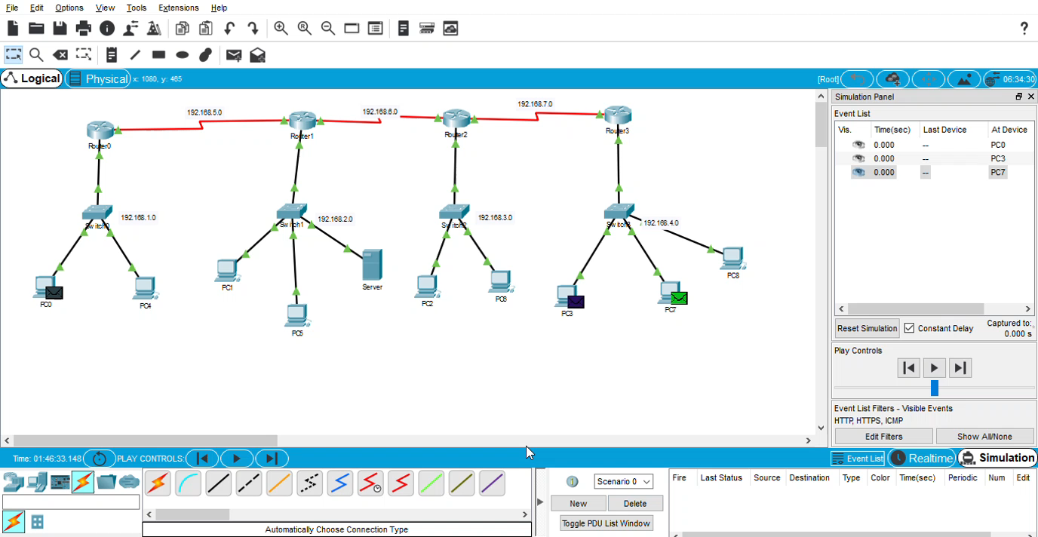
Simulation Result

Slide 23
Conclusion
Based on the efficiency and low in complexity ,we finally came up with these SVM and KNN algorithms.
Data Analyzation to detect most occurred attack.
DOS Attacks Implementation and detection.
Blocking of Specific IP address using Cisco Packet Tracer.
he work can be extended to time stamping. Time stamping works well in DoS as it will examine the arrival time and rate of packets.

Slide 24
THANK YOU

